Slide 1
CSE302: Computer Networks Project
IMPROVISING IMAP PROTOCOL BY INTEGRATING SPAM DETECTION MODEL AND IMPLEMENTING SECURE COMMUNICATION USING RSA
Presented By
124157027: Inti Dhiraj,
Guide Name: Dr. R. Kavitha, CSE/SoC, SASTRA University
Date of Presentation: 14.12.2022
1

Slide 2
Points to be discussed
Aim & Objective
Problem Statement
Existing Solutions - Literature Survey
System Configuration : Software, Hardware, Network type, Protocols used
Network Architecture and Workflow
Work Done (Implementation code link)
Sample I/O (screen shot)
References

Slide 3
AIM & OBJECTIVES
The aim of the project is implementing the SMTP, IMAP protocols, in wired and wireless network to simulate the application on Client-Server environment(here Gmail server).
Objective 1: Understanding SMTP, IMAP, MIME protocols
Objective 2: Developing programs to make use of SMTP, IMAP protocols
Objective 3: Creating the spam filter model, RSA cryptosystem
Objective 4: Benefits to the E-mail users

Slide 4

Problem Statement & Solution
Problem Statement: Nowadays many fraudulent mails pop on email clients inbox and he/she clicks on the malicious redirectable links and hence are betrayed or that causes a financial/moral/resources damage such as anonymous money transfers to another account, a virus getting injected into the system, etc.
Keywords: SMTP, IMAP, RSA, Machine Learning
Solution: The key idea is to improvise the existing IMAP by introducing a spam filter, developed using Machine Learning, which will surely affect the current scenario and can decrease the number of fraudulent activities happening. Increases confidentiality of message transfer using RSA cryptosystem over third party servers.

Slide 5
Existing Solutions- LITERATURE SURVEY
S.No | Title of the paper | Year | Comments on base and reference papers
1 | The Development of the Open Machine-Learning Based Anti-Spam Open-MaLBAS | 2021 | Gives an idea about SMTP module, e-mail users security, Machine Learning approaches
2 | A Comprehensive Survey for Intelligent Spam Email Detection | 2019 | Machine learning, phishing attack, spam detection, spam email, spam filtering.

Slide 6
System configuration
Client side
Hardware used:i5 11th Gen processor
Software used: Python programming
Network: wireless
Protocol: SMTP/IMAP
Server side
Hardware used: G-Mail Servers
Protocol: SMTP/IMAP

Slide 7
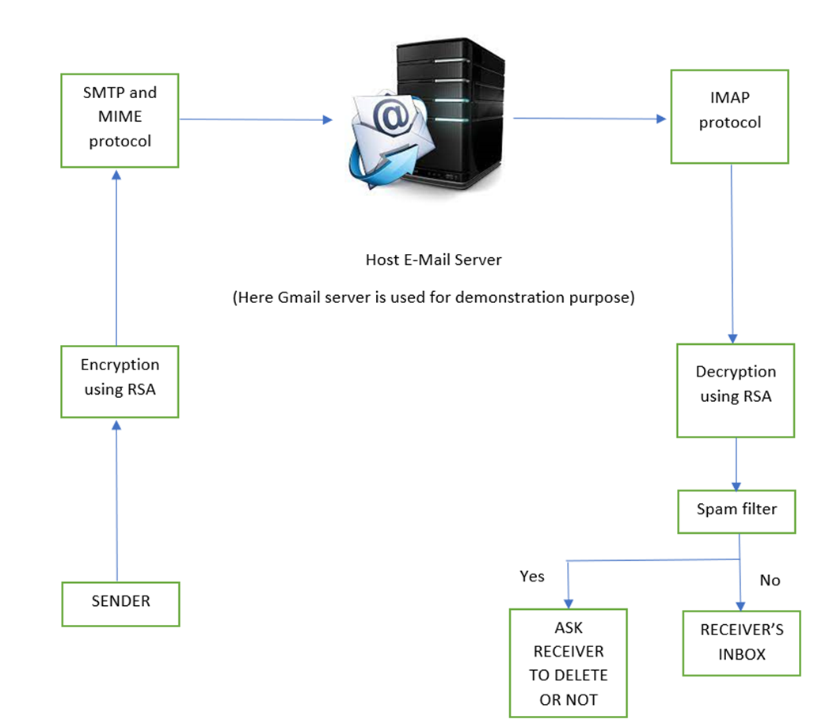
The Work Flow

Slide 8
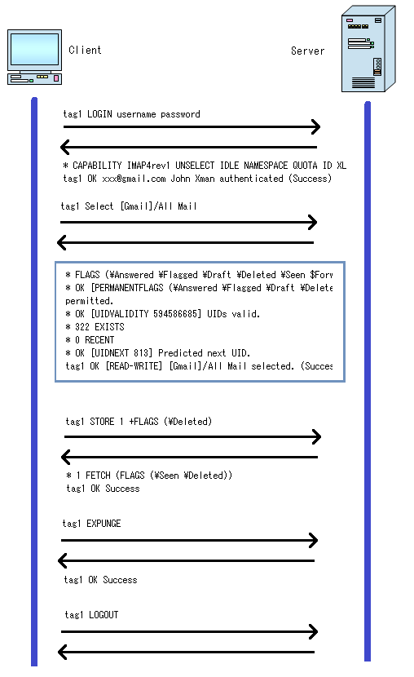
Proposed Protocol Description
RFC number: 9051
Features of the protocol :
1)IMAP only downloads a message to the client when the user clicks on it; attachments are not automatically downloaded.
2)An IMAP server listens on port number 143, while IMAP over Secure Sockets Layer (SSL)/Transport Layer Security is assigned port number 993.
3)A spam filter integrated with the protocol to detect spams.
Limitation of the protocol :
1)Mails won’t work without an active internet connection.
2)Accessing mails is little slower as compared to POP3, as all folders get synchronized every time there is a Send / Receive.

Slide 9
Secure Communication Implementation
RSA CRYPTOGRAPHY:
RSA cryptosystem is one of the classical cryptography algorithms in which the keys are receiver generated key pairs, the public key is given to the authoritative sender and the private key is kept with the receiver. The assumption made while designing RSA system is it is difficult to factorize a large number which is in fact a product of two prime numbers. The public key consists of two numbers where one number is a multiplication of two large prime numbers. Private key is also derived from those two primes numbers. So, suppose the large number gets factorized, the private key will be unearthed. Therefore, encryption strength totally lies on the key size, solution to this can be increasing the size of the key, or the prime numbers contributing to form the large number. It is a receiver-initiated algorithm hence ensures confidentiality.
Step 1: Alice encrypts the message using Bob's public key in step one.
Step 2: Bob receives the encrypted message
Step 3: Bob decrypts the message using his private key

Slide 10
The Spam Filter
A program known as a spam filter is used to identify unsolicited, undesired, and virus-infected emails and stop them from reaching a user's mailbox. A spam filter, like other filtering systems, searches for certain standards on which to base its decisions.
Email spam filtering systems are used by Internet service providers (ISPs), enterprises, and free online email services to reduce the danger of spam distribution. For instance, one of the first and most basic spam filtering systems, like the one used by Microsoft's Hotmail, was configured to look for specific terms in message subject lines. When the filter detected one of the predefined terms, the email was not added to the user's inbox.
This approach is not particularly efficient and frequently leaves out completely acceptable messages, known as false positives, while allowing true spam messages to pass. Using suspicious word patterns or word frequency, more advanced systems, including Bayesian filters and other heuristic filters, can identify spam messages. They accomplish this by gaining insight into the user's preferences from the emails flagged as spam. When new emails are sent that are intended for the user's inbox, the spam program creates rules and applies them. Here we have developed an ML model using logistic regression model with an accuracy of 96.70%.

Slide 11
Work done so far
Dataset used: https://drive.google.com/file/d/1uzbhec5TW_OjFr4UUZkoMm0rpyvYdhZw/view
Source code:
https://drive.google.com/drive/folders/1rDcz6oHNJOv6h_BbQebHd4DBGPgMRM8o
Output video:
https://drive.google.com/file/d/1kIJ3i1okX8NMIKIGFqjAujxBEFo1bAf3/view?sp=share_link

Slide 12

Sample I/O screenshots
Input: Mail body
Output: Spam or Ham

Slide 13
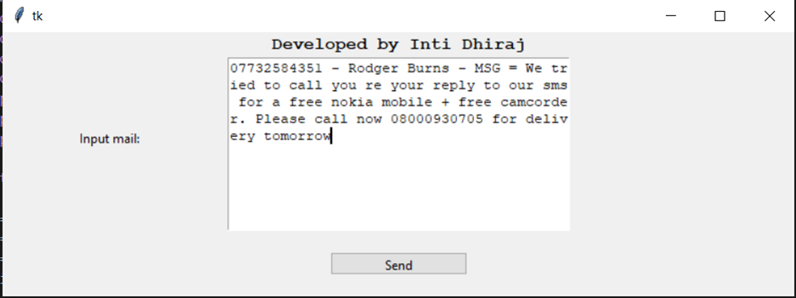
GUI to send mail: -

Slide 14
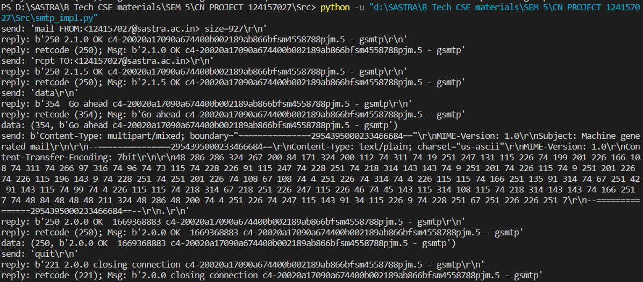
Sending mail: -

Slide 15
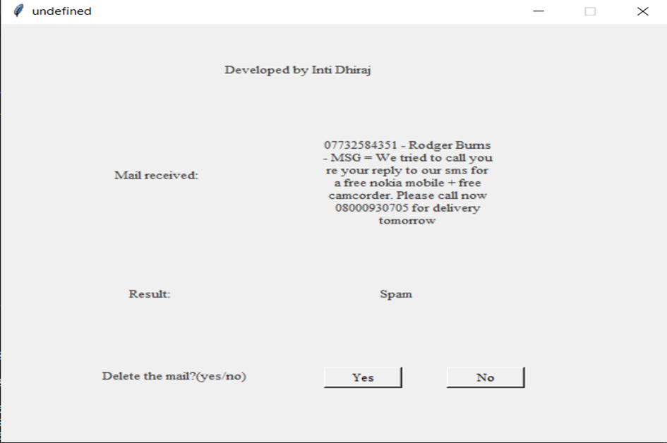
GUI on recipient side (Clicks yes):-

Slide 16
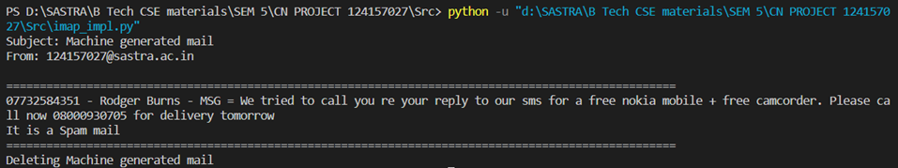
Receiver clicks on yes and mail is deleted:-

Slide 17
Conclusion and Future Work
Conclusion:
Mailing is very common nowadays, working on this project has led to development of an application which can remotely log in to the email account and perform various functions such as sending a mail or fetching a mail and also classifying it as a spam or not. Also, this application improves confidentiality and authenticity while communicating over third-party email servers, moreover the user’s experience is enriched, and hence life is made easy. This project is also helpful in understanding the simple mechanism of mail transfer protocols and RSA cryptosystem. Space management is achieved in using this application.
Future Works:
1)Other functionalities like regular cleanup can be implemented.
2)Post quantum cryptography may be implemented to increase the security of the cryptosystem employed. 3)Develop own server, with a registered domain name, i.e., setting up SMTP and IMAP server for email users.

Slide 18
References
IEEE papers: -
A. Karim, “Comprehensive Survey for Intelligent Spam Email Detection”, December 4, 2019).
Maryam Hina, Mohsan Ali, Abdul Rehman Javed, Gautam Srivastava, Thippa Reddy Gadekallu, Zunera Jalil, “Email Classification and Forensics Analysis using Machine Learning”, 2021.
Online resources: -
https://www.techtarget.com/whatis/definition/IMAP-Internet-Message-Access-Protocol#:~:text=The%20headers%20of%20all%20emails,Office%20Protocol%203%20(POP3).
https://www.youtube.com/watch?v=rxkGItX5gGE
https://www.techtarget.com/whatis/definition/MIME-Multi-Purpose-Internet-Mail-Extensions#:~:text=MIME%20(Multipurpose%20Internet%20Mail%20Extensions)%20is%20an%20extension%20of%20the,and%20application%20programs%2C%20over%20email.
https://realpython.com/python-send-email/

Slide 19
Thank You

